Slide 1
Concurrency
JAVA graduates, NOVEMBER 2017

Slide 2
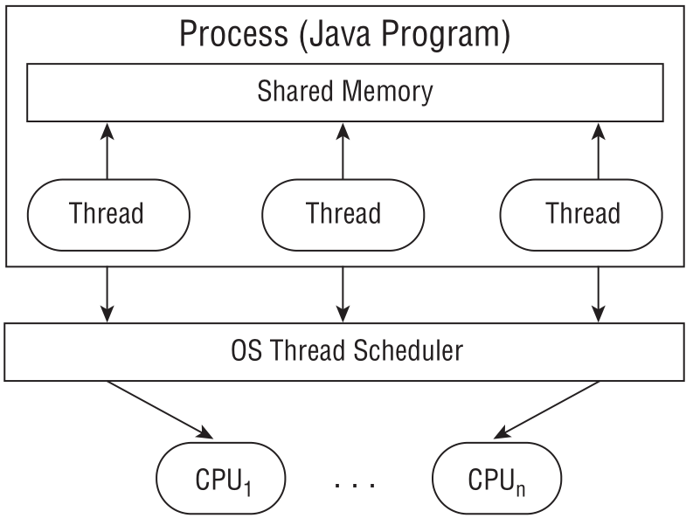
Introducing Threads
A thread is the smallest unit of execution that can be scheduled by the operating system
A process is a group of associated threads that execute in the same, shared environment
A system thread is created by the JVM and runs in the background of the application (ex: garbage collection)
A user-defined thread is one created by the application developer to accomplish a specific task

Slide 3
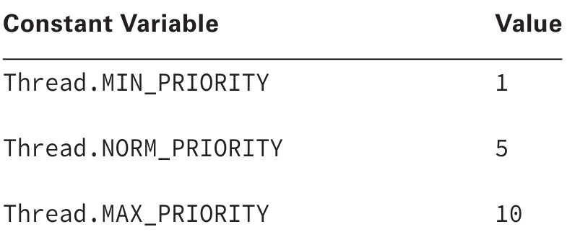
Understanding Thread Concurrency
The property of executing multiple threads and processes at the same time is referred to as concurrency
Operating systems use a thread scheduler to determine which threads should be currently executing (ex. round-robin scheduler)
A context switch is the process of storing a thread’s current state and later restoring the state of the thread to continue execution -> allows multiple threads to access the CPU
A thread priority is a numeric value associated with a thread that is taken into consideration by the thread scheduler when determining which threads should currently be executing

Slide 4
Introducing Runnable
The interface Runnable has existed since the very first version of Java and is commonly used to define the work a thread will execute, separate from the main application thread (method is void)
public interface Runnable {
void run();
}
public class CalculateAverage implements Runnable {
public void run() {
// Define work here
}
}

Slide 5
Introducing RunnablE
It is also useful if you need to pass information to your Runnable object to be used by the run() method, such as in the following class constructor:
public class CalculateAverages implements Runnable {
private double[] scores;
public CalculateAverages(double[] scores) {
this.scores = scores;
}
public void run() {
// Define work here that uses the scores object
}
}

Slide 6
Creating a Thread
There are 2 + 1 ways to define threads/workers in Java:
Extend the java.lang.Thread class (run() method is void) -> Create a class that extends Thread and overrides the run() method.
Implement the java.lang.Runnable interface or use its lambda expression (run method is void) -> Provide a Runnable object or lambda expression to the Thread constructor. You can also pass it to an ExecutorService and then call its execute() or submit() methods.
Implement the java.lang.Callable interface or use its lambda expression (call() method is NOT void) -> similar to Runnable but you can pass and receive parameters to/from the call() method and you submit the Callable class to a java.util.concurrent.ExecutorService and NOT a Thread. From the ExecutorService submit() method you get a asynchronous promise, a Future object which will eventually provide you with a result when you call the future.get() method.
For 1 and 2(first part) remember to start the task with the Thread.start() method and not run()
Notes:
Examples at com.endava.concurrency.runnable.PrintData.java, com.endava.concurrency.thread.ReadInventoryThread.java and com.endava.concurrency.ThreadRunnableExamples.java

Slide 7
TIPS
If you need to define your own Thread rules upon which multiple tasks will rely, such as a priority thread, extending Thread may be preferable.
Since Java doesn't support multiple inheritance, extending Thread does not allow you to extend any other class, whereas implementing Runnable lets you extend another class.
Implementing Runnable is often a better object-oriented design practice since it separates the task being performed from the Thread object performing it.
Implementing Runnable allows the class to be used by numerous Concurrency API classes.
Use the ExecutorService, which we will discuss in the next section, to perform thread tasks without having to create Thread objects directly

Slide 8
Polling with Busy waiting
Polling is the process of intermittently checking data at some fixed interval
No guarantee when the loop will terminate (if), counter is not thread safe
public class CheckResults {
static int counter = 0;
public static void main(String[] args) {
// Runnable
new Thread(new BusyWaitingCounter()).start();
// busy waiting -> bad coding practice
while (CheckResults.counter < 100) {
System.out.println("Not reached yet");
}
System.out.println("Reached!");
}
}
Notes:
Examples at com.endava.concurrency.polling.CheckResultsBusyWaiting.java and com.endava.concurrency.polling.CheckResultsSleep.java

Slide 9
Polling with Sleep
public class CheckResultsSleep {
static int counter = 0;
public static void main(String[] args) throws InterruptedException {
// Runnable
new Thread(new SleepCounter()).start();
// no busy waiting -> sleep does not occupy CPU time continuously
while (CheckResultsSleep.counter < 100) {
System.out.println("Not reached yet");
Thread.sleep(1000); // 1 SECOND
}
System.out.println("Reached!");
}
}
Notes:
Examples at com.endava.concurrency.polling.CheckResultsBusyWaiting.java and com.endava.concurrency.polling.CheckResultsSleep.java

Slide 10
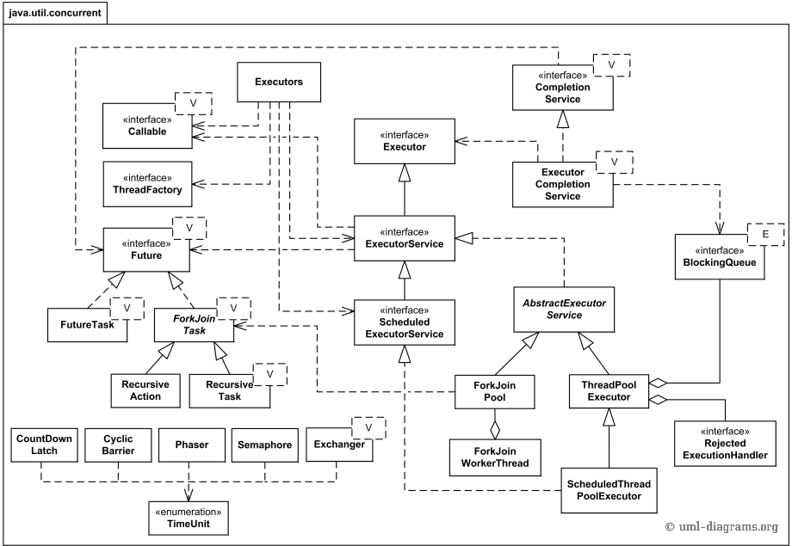
Java 7 java.util.concurrent package

Slide 11
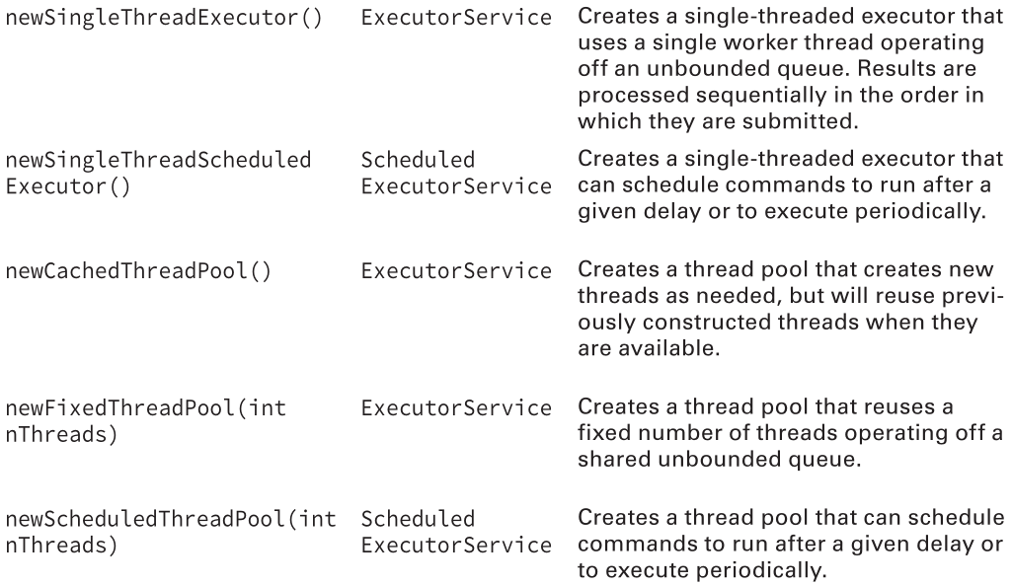
Creating Threads with the ExecutorService
The Concurrency API, introduced the ExecutorService, which creates and manages threads
Obtain an instance of an ExecutorService interface -> you send the service tasks to be processed

Slide 12
Single-Thread Executor
The Concurrency API includes the Executors factory class that can be used to create instances of the ExecutorService object (which supports both Runnable and Callable objects)
ExecutorService service = null;
try {
service = Executors.newSingleThreadExecutor();
System.out.println("begin");
service.execute(new PrintInput("Printing zoo inventory"));
service.execute(new PrintRecords());
service.execute(new PrintInput("Printing zoo inventory"));
System.out.println("end");
} finally {
if (service != null)
service.shutdown();
}
Notes:
Examples at com.endava.concurrency.executorservice.ZooInfoSingleThreadExecutor.java

Slide 13
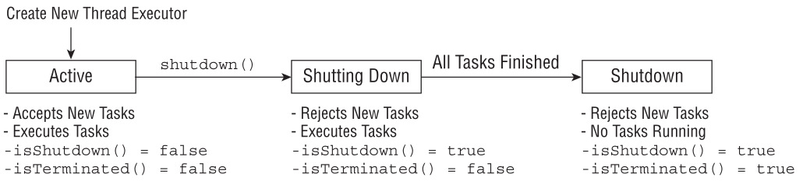
Shutting Down a Thread Executor
Once you have finished using a thread executor, it is important that you call the shutdown() method.
A thread executor creates a non-daemon thread on the first task that is executed, so failing to call shutdown() will result in your application never terminating
shutdown() does not actually stop any tasks that have already been submitted to the thread executor
shutdownNow() attempts to stop all running tasks and discards any that have not been started yet -> returns a List<Runnable> of tasks that were submitted to the thread executor but that were never started
Good practice to close a thread executor in a finally block

Slide 14
Executor Lifecycle
The lifecycle implied by ExecutorService has three states - running, shutting down, and terminated. ExecutorServices are initially created in the running state. The shutdown method initiates a graceful shutdown: no new tasks are accepted but previously submitted tasks are allowed to complete - including those that have not yet begun execution. The shutdownNow method initiates an abrupt shutdown: it attempts to cancel outstanding tasks and does not start any tasks that are queued but not begun.
Tasks submitted to an ExecutorService after it has been shut down are handled by the rejected execution handler, which might silently discard the task or might cause execute to throw the unchecked RejectedExecutionException. Once all tasks have completed, the ExecutorService transitions to the terminated state.

Slide 15
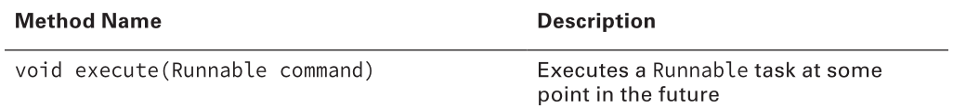
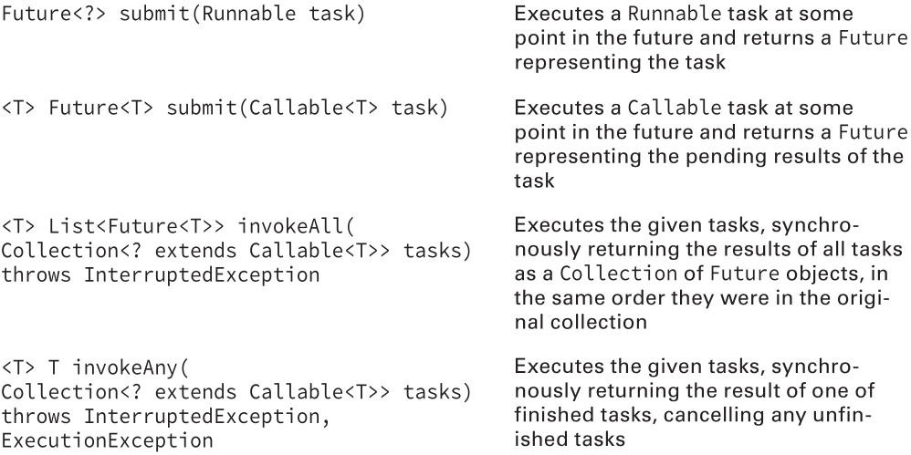
Submitting Tasks

Slide 16
Submitting Task Collections
Both invokeAll() and invokeAny() take a Collection object containing a list of tasks to execute
Both of these methods execute synchronously -> will wait until the results are available before returning control
invokeAll():
Executes all tasks;
Returns a List of ordered Future objects with one Future object corresponding to each submitted task, in the order they were in the original collection
Future.isDone() returns true for each element in the returned List
A task could have completed normally or thrown an exception
Will wait indefinitely until all tasks are complete
An overloaded version exists that takes a timeout value and TimeUnit parameter

Slide 17
Submitting Task Collections
Both invokeAll() and invokeAny() take a Collection object containing a list of tasks to execute
Both of these methods execute synchronously -> will wait until the results are available before returning control
invokeAny():
Executes a collection of tasks
Returns the result of one of the tasks that successfully completes execution, cancelling all unfinished tasks
Any completed task can be returned
Will wait indefinitely until at least one task completes
An overloaded version exists that takes a timeout value and TimeUnit parameter

Slide 18
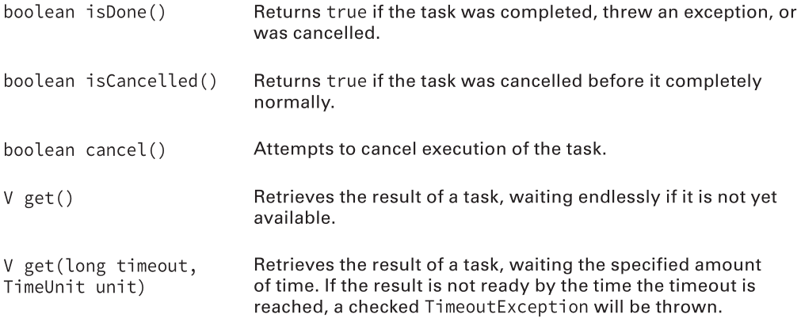
Waiting for Results
Future<?> future = service.submit(() -> System.out.println("Hello Zoo"));
Notes:
Examples at com.endava.concurrency.executorservice.CheckResultsExecutorService.java

Slide 19
Introducing Callable
Callable is similar to Runnable except that its call() method returns a value and can throw a checked exception -> allows more details to be retrieved easily from the task after it is completed
Unlike Runnable, in which the get() methods always return null, the get() methods on a Future object return the matching generic type or null
public interface Callable<V> {
V call() throws Exception;
}
class CallableSum implements Callable<Integer> {
int value1; int value2;
CallableSum(int value1, int value2) {
this.value1 = value1;
this.value2 = value2;
}
@Override
public Integer call() throws Exception {
return value1 + value2;
}
}
Notes:
Examples at com.endava.concurrency.executorservice.AddDataExecutorServiceCallable.java

Slide 20
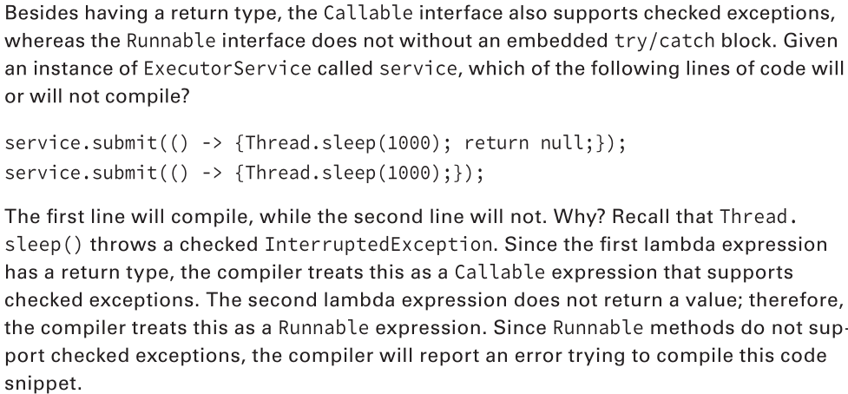
Checked exceptions in Callable and Runnable
Notes:
Examples at com.endava.concurrency.executorservice.CallableVsRunnableExecutorService.java

Slide 21
Waiting for All Tasks to Finish
After submitting a set of tasks to a thread executor, it is common to wait for the results
One solution is to call get() on each Future object returned by the submit() method
Another solution is to pass a List of Callable objects to the invokeAll() method to the ExecutorService
We could also use the awaitTermination(long timeout, TimeUnit unit) method
// ...
} finally {
if (service != null)
service.shutdown();
}
if (service != null) {
service.awaitTermination(1, TimeUnit.MINUTES);
// Check whether all tasks are finished
if (service.isTerminated())
System.out.println("All tasks finished");
else
System.out.println("At least one task is still running");
}
Notes:
Examples at com.endava.concurrency.executorservice.AwaitTerminationExecutorService.java

Slide 22
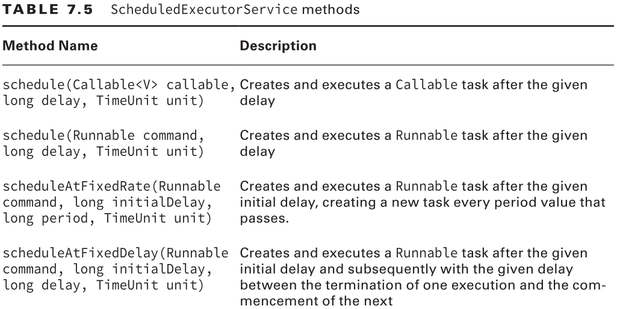
Scheduling Tasks
The ScheduledExecutorService, which is a subinterface of ExecutorService, can be used to schedule a task to happen at some future time or to happen repeatedly, at some set interval
ScheduledExecutorService service = Executors.newSingleThreadScheduledExecutor();
Notes:
Examples at com.endava.concurrency.executorservice.scheduled.SimpleScheduleDelay.java

Slide 23
Scheduling Tasks
The scheduleAtFixedRate() method creates a new task and submits it to the executor every period, regardless of whether or not the previous task finished
// wait 5 minutes and then run every 1 minute
service.scheduleAtFixedRate(command,5,1,TimeUnit.MINUTE);
One risk of using this method is the possibility a task could consistently take longer to run than the period between tasks
The scheduleAtFixedDelay() method creates a new task after the previous task has finished
// wait 0 minutes, then run a task, wait for it to finish, wait 2 minutes, run // another time, etc…
service.scheduleAtFixedDelay(command,0,2,TimeUnit.MINUTE);
Neither of the above methods use Callable because they would generate an infinite number of Future objects
Notes:
Examples at com.endava.concurrency.executorservice.scheduled.FixedRateAndFixedDelay.java

Slide 24
Increasing Concurrency with Pools
All of our previous examples are compatible with the new pooled-thread executors from slide 11
A single-thread executor will wait for an available thread to become available before running the next task -> a pooled-thread executor can execute the next task concurrently
If the pool runs out of available threads, the task will be queued by the thread executor and wait to be completed
The newCachedThreadPool() method will create a thread pool of unbounded size, allocating a new thread anytime one is required or all existing threads are busy (pools that require executing many short-lived asynchronous tasks)
ScheduledExecutorService service = Executors.newScheduledThreadPool(10);
service.scheduleAtFixedRate(command,3,1,TimeUnit.MINUTE);

Slide 25
Managing Concurrent Processes – Cyclic Barrier
The Concurrency API includes classes that can be used to coordinate tasks among a group of related threads -> CyclicBarrier
Allows us to perform complex, multi-threaded tasks, while all threads stop and wait at logical barriers
The CyclicBarrier takes in its constructors a limit value, indicating the number of threads to wait for
As each thread finishes, it calls the await() method on the cyclic barrier
Once the specified number of threads have each called await(), the barrier is released/broken and all threads can continue
Number of available threads must to be at least as large the CyclicBarrier limit value
After a CyclicBarrier is broken, all threads are released and the number of threads waiting on the CyclicBarrier goes back to zero -> reusable
Notes:
Examples at com.endava.concurrency.cyclicbarrier.LionPenManagerNoCyclicBarrier.java and com.endava.concurrency.cyclicbarrier.LionPenManagerCyclicBarrier.java

Slide 26
Protecting Data with Atomic Classes
java.util.concurrent.atomic package used to help coordinate access to primitive values and object references
Atomic is the property of an operation to be carried out as a single unit of execution without any interference by another thread.
A thread-safe atomic version of the increment operator would be one that performed the read and write of the variable as a single operation, not allowing any other threads to access the variable during the operation.

Slide 27
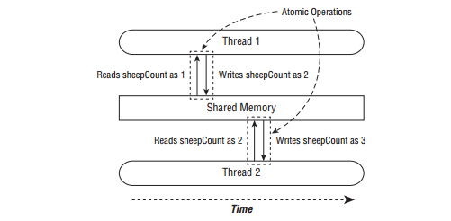
Thread synchronization using atomic operations
Notes:
Any thread trying to access the sheepCount variable while an atomic operation is in process will have to wait until the atomic operation on the variable is complete.
Of course, this exclusivity applies only to the threads trying to access the sheepCount variable, with the rest of the memory space not affected by this operation.
Since accessing primitives and references in Java is common in shared environments, the Concurrency API includes numerous useful classes that are conceptually the same as our primitive classes but that support atomic operations.

Slide 28
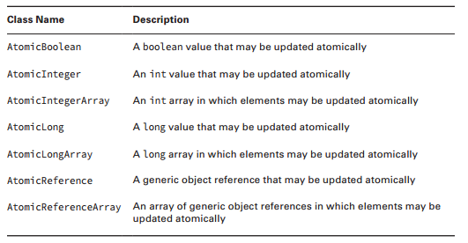
Atomic classes
Notes:
How do we use an atomic class? Each class includes numerous methods that are equivalent to many of the primitive built-in operators that we use on primitives, such as the assignment operator = and the increment operators ++. We describe the common atomic methods that you should know for the exam in the next slide.

Slide 29
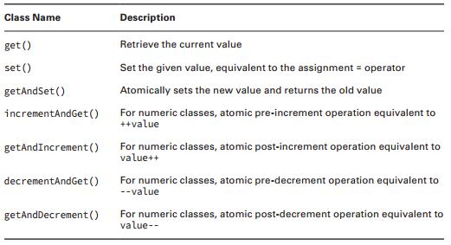
Atomic methods
Notes:
In the following example, we update our SheepManager class with an AtomicInteger : private AtomicInteger sheepCount = new AtomicInteger(0); private void incrementAndReport() { System.out.print(sheepCount.incrementAndGet()+" "); }

Slide 30
Improving Access with Synchronized Blocks
A monitor is a structure that supports mutual exclusion or the property that at most one thread is executing a particular segment of code at a given time.
In Java, any Object can be used as a monitor, along with the synchronized keyword, as shown in the following example:
SheepManager manager = new SheepManager();
synchronized(manager) {
// Work to be completed by one thread at a time
}
Notes:
This example is referred to as a synchronized block . Each thread that arrives will first check if any threads are in the block. In this manner, a thread “acquires the lock” for the monitor. If the lock is available, a single thread will enter the block, acquiring the lock and preventing all other threads from entering. While the first thread is executing the block, all threads that arrive will attempt to acquire the same lock and wait for fi rst thread to finish. Once a thread finishes executing the block, it will release the lock, allowing one of the waiting threads to proceed.
Let’s revisit our SheepManager example and see if we can improve the results so that each worker increments and outputs the counter in order. Let’s say that we replaced our for() loop with the following implementation: for(int i=0; i manager.incrementAndReport()); } }

Slide 31
Synchronizing Methods
We can add the synchronized modifier to any instance method to synchronize automatically on the object itself. For example, the following two method definitions are equivalent:
private void incrementAndReport() {
synchronized(this) {
System.out.print((++sheepCount)+" ");
}
}
private synchronized void incrementAndReport() {
System.out.print((++sheepCount)+" ");
}
Notes:
In the previous example, we established our monitor using synchronized(this) around the body of the method. Java actually provides a more convenient compiler enhancement for doing so.
The first uses a synchronized block, whereas the second uses the synchronized method modifier. Which you use is completely up to you. We can also add the synchronized modifier to static methods. What object is used as the monitor when we synchronize on a static method? The class object, of course! For example, the following two methods are equivalent for static synchronization inside our SheepManager class:
public static void printDaysWork() { synchronized(SheepManager.class) { System.out.print("Finished work"); } }
public static synchronized void printDaysWork() { System.out.print("Finished work"); }

Slide 32
Understanding the Cost of Synchronization
While multi-threaded programming is about doing multiple things at the same time, synchronization is about taking multiple threads and making them perform in a more single-threaded manner.
For example, let’s say that we have a highly concurrent class with numerous methods that synchronize on the same object. Let’s say that 50 concurrent threads access it. Let’s also say that, on average, each thread takes a modest 100 milliseconds to execute. In this example, if all of the threads try to access the monitor at the same time, how long will it take for them to complete their work, assuming that 50 threads are available in the thread pool?
50 threads x 100 milliseconds = 5,000 milliseconds = 5 seconds

Slide 33
Wait-and-Notify API Tour
The java.lang.Object class provides a Wait-and-Notify API that consists of three wait()methods, one notify() method, and one notifyAll() method. The wait() methods wait for a condition to exist; the notify() and notifyAll() methods notify waiting threads when the condition exists:
void wait(): Cause the current thread to wait until another thread invokes the notify() or notifyAll() method for this object, or for some other thread to interrupt the current thread while waiting.
void wait(long timeout): Cause the current thread to wait until another thread invokes the notify() or notifyAll() method for this object, or for the specified amount of time measured in milliseconds (identified by timeout) to pass, or for some other thread to interrupt the current thread while waiting. This method throws java.lang.IllegalArgumentException when timeout is negative.
void wait(long timeout, int nanos): Cause the current thread to wait until another thread invokes the notify() or notifyAll() method for this object, or for the specified amount of time measured in milliseconds (identified by timeout) plus nanoseconds (identified by nanos) to pass, or for some other thread to interrupt the current thread while waiting. This method throws IllegalArgumentException when timeout is negative, nanos is negative, or nanos is greater than 999999.

Slide 34
Wait-and-Notify API Tour
void notify(): Wake up a single thread that’s waiting on this object’s monitor. If any threads are waiting on this object, one of them is chosen to be awakened. The choice is arbitrary and occurs at the discretion of the implementation. The awakened thread will not be able to proceed until the current thread relinquishes the lock on this object. The awakened thread will compete in the usual manner with any other threads that might be actively competing to synchronize on this object; for example, the awakened thread enjoys no reliable privilege or disadvantage in being the next thread to lock this object.
void notifyAll(): Wake up all threads that are waiting on this object’s monitor. The awakened threads will not be able to proceed until the current thread relinquishes the lock on this object. The awakened threads will compete in the usual manner with any other threads that might be actively competing to synchronize on this object; for example, the awakened threads enjoy no reliable privilege or disadvantage in being the next thread to lock this object.
The three wait() methods throw java.lang.InterruptedException when any thread interrupted the current thread before or while the current thread was waiting for a notification. The interrupted status of the current thread is cleared when this exception is thrown.

Slide 35
Synchronized Collections
The synchronized collections classes, Hashtable and Vector, and the synchronized wrapper classes, Collections.synchronizedMap() and Collections.synchronizedList(), provides a basic conditionally thread-safe implementation of Map and List.
You can get a synchronized version of a Java Collection with:
Synchronized Collection Methods of Collections class
Collections.synchronizedCollection(Collection<T> c)
Collections.synchronizedList(List<T> list)
Collections.synchronizedMap(Map<K,V> m)
Collections.synchronizedSet(Set<T> s)
Collections.synchronizedSortedMap(SortedMap<K,V> m)
Collections.synchronizedSortedSet(SortedSet<T> s)
Notes:
However, several factors make them unsuitable for use in highly concurrent applications,
most importantly their single collection-wide lock is an impediment to scalability and it often becomes necessary
to lock a collection for a considerable time during iteration to prevent ConcurrentModificationException.

Slide 36
Concurrent Collections
The Concurrency API includes interfaces and classes that help you coordinate access to collections across multiple tasks. By collections, we are of course referring to the Java Collections Framework.
public class ZooManager {
private Map foodData = new HashMap();
public synchronized void put(String key, String value) {
foodData.put(key, value);
}
public synchronized Object get(String key) {
return foodData.get(key);
}
}
public class ZooManager {
private Map foodData = new ConcurrentHashMap();
public void put(String key, String value) {
foodData.put(key, value);
}
public Object get(String key) {
return foodData.get(key);
}
}
Notes:
So then, why use a concurrent collection class? Like using ExecutorService to manage threads for us, using the concurrent collections is extremely convenient in practice. It also prevents us from introducing mistakes in own custom implementation, such as if we forgot to synchronize one of the accessor methods. In fact, the concurrent collections often include performance enhancements that avoid unnecessary synchronization. Accessing collections from across multiple threads is so common that the writers of Java thought it would be a good idea to have alternate versions of many of the regular collections classes just for multi-threaded access.

Slide 37
Understanding Memory Consistency Errors
A memory consistency error occurs when two threads have inconsistent views of what should be the same data.
Conceptually, we want what we write on one thread to be available to another thread if it accesses the concurrent collection after the write has occurred. When two threads try to modify the same non-concurrent collection, the JVM may throw a ConcurrentModificationException at runtime. In fact, it can happen with a single thread. (not really but still as an example)
Map foodData = new HashMap();
foodData.put("penguin", 1);
foodData.put("flamingo", 2);
for(String key: foodData.keySet())
foodData.remove(key);
Map foodData = new ConcurrentHashMap(); foodData.put("penguin", 1);
foodData.put("flamingo", 2);
for(String key: foodData.keySet())
foodData.remove(key);
Notes:
The purpose of the concurrent collection classes is to solve common memory consistency errors.
A memory consistency error occurs when two threads have inconsistent views of what should be the same data. Conceptually, we want writes on one thread to be available to another thread if it accesses the concurrent collection after the write has occurred. When two threads try to modify the same non-concurrent collection, the JVM may throw a ConcurrentModificationException at runtime. In fact, it can happen with a single thread. Take a look at the following code snippet.
This snippet will throw a ConcurrentModificationException at runtime, since the iterator keyset() is not properly updated after the first element is removed. Changing the first line to use a ConcurrentHashMap will prevent the code from throwing an exception at runtime.

Slide 38
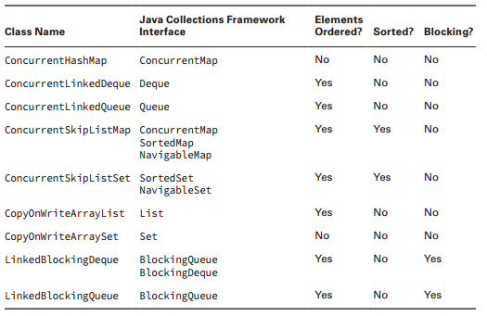
Working with Concurrent Classes

Slide 39
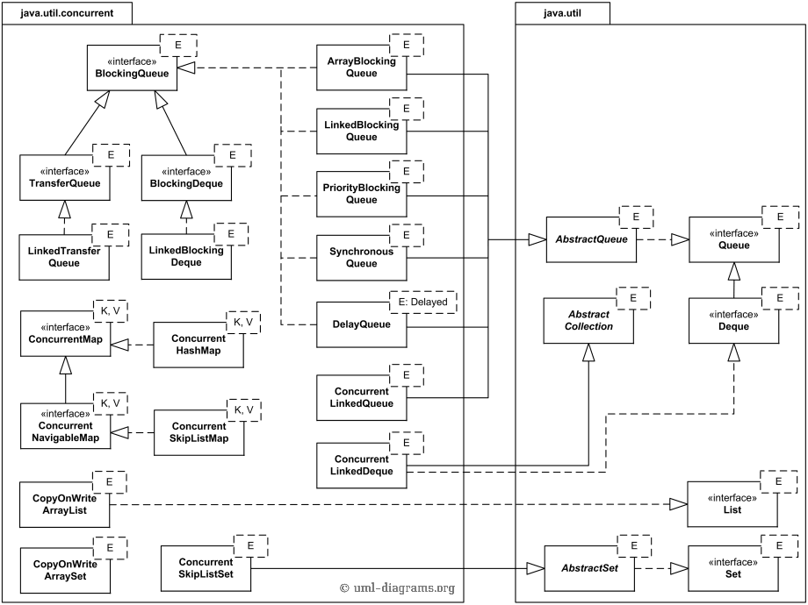
Working with Concurrent Classes

Slide 40
Working with Concurrent Classes
Map map = new ConcurrentHashMap<>(); map.put("zebra", 52);
map.put("elephant", 10); System.out.println(map.get("elephant"));
Queue queue = new ConcurrentLinkedQueue<>(); queue.offer(31);
System.out.println(queue.peek()); System.out.println(queue.poll());
Deque deque = new ConcurrentLinkedDeque<>(); deque.offer(10);
deque.push(4);
System.out.println(deque.peek());
System.out.println(deque.pop());

Slide 41
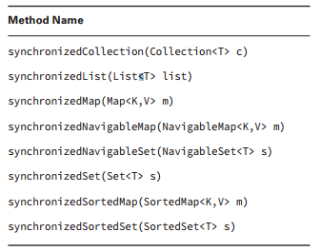
Obtaining Synchronized Collections
The Concurrency API also includes methods for obtaining synchronized versions of existing non-concurrent collection objects. These methods, defined in the Collections class, contain synchronized methods that operate on the inputted collection and return a reference that is the same type as the underlying collection.

Slide 42
Identifying Threading Problems
Liveness is the ability of an application to be able to execute in a timely manner. Liveness problems, then, are those in which the application becomes unresponsive or in some kind of “stuck” state. For the exam, there are three types of liveness issues with which you should be familiar: deadlock, starvation, and livelock.
Deadlock occurs when two or more threads are blocked forever, each waiting on the other.
Starvation occurs when a single thread is perpetually denied access to a shared resource or lock. The thread is still active, but it is unable to complete its work as a result of other threads constantly taking the resource that they trying to access.
Livelock occurs when two or more threads are conceptually blocked forever, although they are each still active and trying to complete their task. Livelock is a special case of resource starvation in which two or more threads actively try to acquire a set of locks, are unable to do so, and restart part of the process. Livelock is often a result of two threads trying to resolve a deadlock.
Notes:
Starvation describes a situation where a thread is unable to gain regular access to shared resources and is unable to make progress. This happens when shared resources are made unavailable for long periods by "greedy" threads.
A thread often acts in response to the action of another thread. If the other thread's action is also a response to the action of another thread, then livelock may result. As with deadlock, livelocked threads are unable to make further progress. However, the threads are not blocked — they are simply too busy responding to each other to resume work.

Slide 43
Preventing Deadlocks
How do you fix a deadlock once it has occurred?
The answer is that you can't in most situations. On the other hand, there are numerous strategies to help prevent deadlocks from ever happening in the first place. One common strategy to avoid deadlocks is for all threads to order their resource requests. For example, if both foxes have a rule that they need to obtain food before water, then the previous deadlock scenario will not happen again. Once one of the foxes obtained food, the second fox would wait, leaving the water resource available. There are some advanced techniques that try to detect and resolve a deadlock in real time, but they are often quite difficult to implement and have limited success in practice. In fact, many operating systems ignore the problem altogether and pretend that deadlocks never happen.

Slide 44
STREAMS
JAVA graduates, NOVEMBER 2017

Slide 45
LAMBDAS IN A NUTSHELL
A lambda expression can be understood as a concise representation of an anonymous function that can be passed around: it doesn’t have a name, but it has a list of parameters, a body, a return type, and also possibly a list of exceptions that can be thrown. That’s one big definition; let’s break it down:
Anonymous— We say anonymous because it doesn’t have an explicit name like a method would normally have: less to write and think about!
Function— We say function because a lambda isn’t associated with a particular class like a method is. But like a method, a lambda has a list of parameters, a body, a return type, and a possible list of exceptions that can be thrown.
Passed around— A lambda expression can be passed as argument to a method or stored in a variable.
Concise— You don’t need to write a lot of boilerplate like you do for anonymous classes.

Slide 46
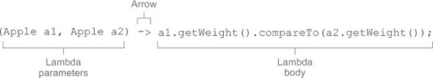
LAMBDAS IN A NUTSHELL
A list of parameters— In this case it mirrors the parameters of the compare method of a Comparator—two Apples.
An arrow— The arrow -> separates the list of parameters from the body of the lambda.
The body of the lambda— Compare two Apples using their weights. The expression is considered the lambda’s return value.
(parameters) -> expression
(parameters) -> { statements; }

Slide 47
LAMBDAS IN A NUTSHELL
Functional interface | Function descriptor | Primitive specializations
Predicate<T> | T -> boolean | IntPredicate, LongPredicate, DoublePredicate
Consumer<T> | T -> void | IntConsumer, LongConsumer, DoubleConsumer
Function<T, R> | T -> R | IntFunction<R>, IntToDoubleFunction, IntToLongFunction, LongFunction<R>, LongToDoubleFunction, LongToIntFunction, DoubleFunction<R>, ToIntFunction<T>, ToDoubleFunction<T>, ToLongFunction<T>
Supplier<T> | () -> T | BooleanSupplier, IntSupplier, LongSupplier, DoubleSupplier
UnaryOperator<T> | T -> T | IntUnaryOperator, LongUnaryOperator, DoubleUnaryOperator
BinaryOperator<T> | (T, T) -> T | IntBinaryOperator, LongBinaryOperator, DoubleBinaryOperator
BiPredicate<L, R> | (L, R) -> boolean
BiConsumer<T, U> | (T, U) -> void | ObjIntConsumer<T>, ObjLongConsumer<T>, ObjDoubleConsumer<T>
BiFunction<T, U, R> | (T, U) -> R | ToIntBiFunction<T, U>, ToLongBiFunction<T, U>, ToDoubleBiFunction<T, U>

Slide 48
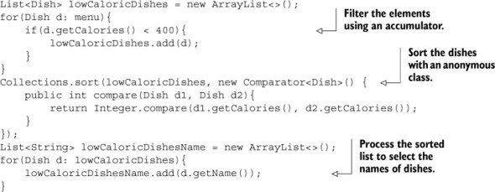
WHAT ARE STREAMS?
Streams are an update to the Java API that lets you manipulate collections of data in a declarative way (you express a query rather than code an ad hoc implementation for it). For now you can think of them as fancy iterators over a collection of data. In addition, streams can be processed in parallel transparently, without you having to write any multithreaded code!
Java 7 code:

Slide 49
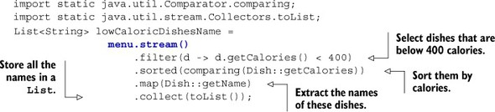
WHAT ARE STREAMS?

Slide 50
WHAT ARE STREAMS?
So first, what exactly is a stream? A short definition is “a sequence of elements from a source that supports data processing operations.” Let’s break down this definition step by step:
Sequence of elements — Like a collection, a stream provides an interface to a sequenced set of values of a specific element type. Because collections are data structures, they’re mostly about storing and accessing elements with specific time/space complexities (for example, an ArrayList vs. a LinkedList). But streams are about expressing computations such as filter, sorted, and map that you saw earlier. Collections are about data; streams are about computations. We explain this idea in greater detail in the coming sections.
Source — Streams consume from a data-providing source such as collections, arrays, or I/O resources. Note that generating a stream from an ordered collection preserves the ordering. The elements of a stream coming from a list will have the same order as the list.
Data processing operations — Streams support database-like operations and common operations from functional programming languages to manipulate data, such as filter, map, reduce, find, match, sort, and so on. Stream operations can be executed either sequentially or in parallel.

Slide 51
WHAT ARE STREAMS?
In addition, stream operations have two important characteristics:
Pipelining — Many stream operations return a stream themselves, allowing operations to be chained and form a larger pipeline. This enables certain optimizations that we explain in the next chapter, such as laziness and short-circuiting. A pipeline of operations can be viewed as a database-like query on the data source.
Internal iteration — In contrast to collections, which are iterated explicitly using an iterator, stream operations do the iteration behind the scenes for you. We briefly mentioned this idea in chapter 1 and return to it later in the next section.

Slide 52
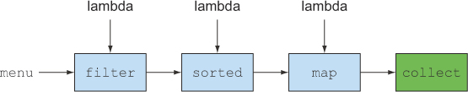
STREAMS
The code is written in a declarative way: you specify what you want to achieve as opposed to specifying how
to implement an operation (using control-flow blocks such as loops and if conditions).
You chain together several building-block operations to express a complicated data processing pipeline
(you chain the filter by linking sorted, map, and collect operations, as illustrated in below figure)
while keeping your code readable and its intent clear. The result of the filter is passed to the sorted method,
which is then passed to the map method and then to the collect method.

Slide 53
STREAMS
To summarize, the Streams API in Java 8 lets you write code that’s
Declarative— More concise and readable
Composable— Greater flexibility
Parallelizable— Better performance

Slide 54
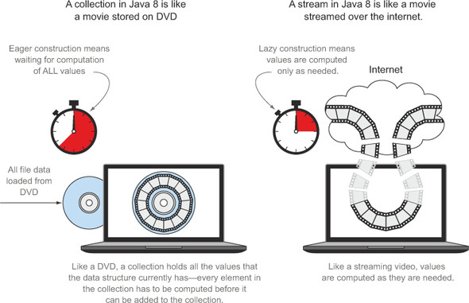
STREAMS VS COLLECTIONS

Slide 55
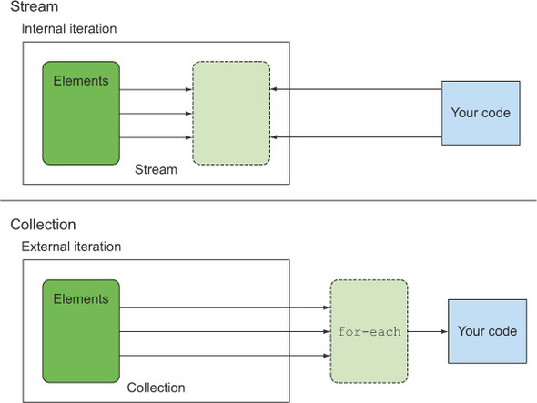
STREAMS VS COLLECTIONS
Internal versus external iteration:

Slide 56
STREAMS INTERMEDIATE OPERATIONS
Operation | Type | Return type | Argument of the operation | Function descriptor
filter | Intermediate | Stream<T> | Predicate<T> | T -> boolean
map | Intermediate | Stream<R> | Function<T, R> | T -> R
limit | Intermediate | Stream<T>
sorted | Intermediate | Stream<T> | Comparator<T> | (T, T) -> int
distinct | Intermediate | Stream<T>

Slide 57
STREAMS TERMINAL OPERATIONS
Operation | Type | Purpose
forEach | Terminal | Consumes each element from a stream and applies a lambda to each of them. The operation returns void.
count | Terminal | Returns the number of elements in a stream. The operation returns a long.
collect | Terminal | Reduces the stream to create a collection such as a List, a Map, or even an Integer. See chapter 6 for more detail.

Slide 58

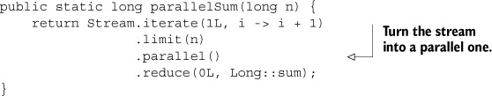
PARALLEL STREAMS
A parallel stream is a stream that splits its elements into multiple chunks, processing each chunk with a different thread. Thus, you can automatically partition the workload of a given operation on all the cores of your multicore processor and keep all of them equally busy.
Let’s suppose you need to write a method accepting a number n as argument and returning the sum of all the numbers from 1 to the given argument. A straightforward (perhaps naïve) approach is to generate an infinite stream of numbers, limiting it to the passed number, and then reduce the resulting stream with a BinaryOperator that just sums two numbers, as follows:

Slide 59
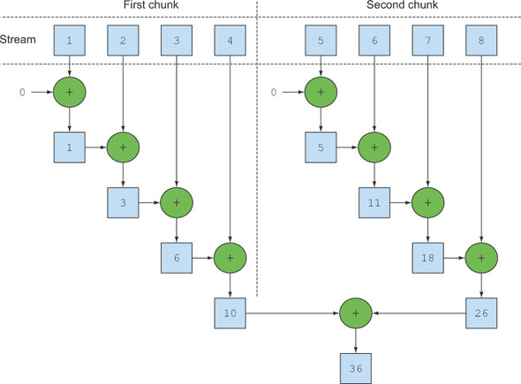
PARALLEL STREAMS

Slide 60
Configuring the thread pool used by parallel streams
Parallel streams internally use the default ForkJoinPool, which by default has as many threads as you have processors, as returned by Runtime.getRuntime().availableProcessors().
But you can change the size of this pool using the system property java.util.concurrent.ForkJoinPool.common.parallelism, as in the following example:
System.setProperty("java.util.concurrent.ForkJoinPool.common.parallelism", "12");

Slide 61
GHEORGHE CAZACU
gheorghe.cazacu@endava.com

